Slide 1
Croeso i
Shirenewton Primary School

Slide 2
shwmae!
Nick Penn - Headteacher
Sarah Burbidge - Acting Deputy Headteacher
Miss Tymms - Current Reception Teacher
Mrs Dekerf, Mrs Farley, Mrs Morcombe - Support Staff

Slide 3
What type of school are we?

Slide 5
Our Vision
Learning Together ... we aim to develop into creative and enterprising individuals who, through a wealth of exciting experiences and challenges in a vibrant learning environment, develop into respectful and inquisitive learners who care about the local community, Wales and the wider world.
Achieving for Life ... we aim to become happy and confident, well rounded individuals who have a life-long love of learning, realising our true potential.

Slide 7
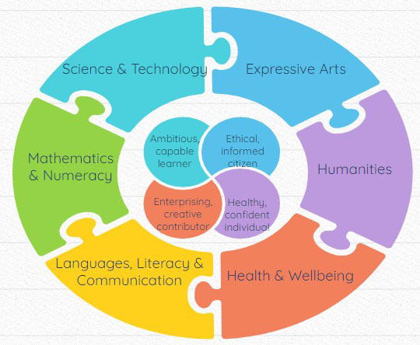

Slide 9
The Early Years

Slide 10
Children learn best through play
Balance between focussed learning and activities chosen by the child
Prompts and challenges in the areas
Emphasis on outdoor learning
Variety of different learning groups ... class, group, individual or ability groups across year groups
Team approach – your child will be taught by a member of the Reception team of staff

Slide 11
Over To You Time (OTYT)
Tîm Coed Coch & Tîm Helyg

Slide 12
OTYT
A 45 minute daily session between the formal literacy and numeracy lessons
Learners are in charge of their own learning, accessing enhanced provision of their choice
1, 2 & 3 star challenges in each zone
Adults observe & move their learning on through play
Continual free-flow between indoor and outdoor play (there is no set playtime)
Learners access the cafe for their snack during this time when they are hungry

Slide 13
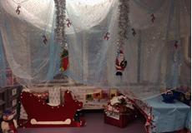
Delve & Discover Day
Following their “Delve & Discover” day where classrooms are transformed overnight according to their new topic - they spend the day doing exciting stimulus activities and then plan together activities to meet the skills they need to be taught next.
These ideas are fed into the planning for indoor and outdoor OTYT areas.

Slide 14
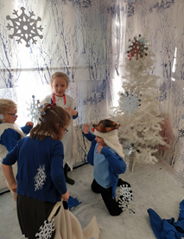
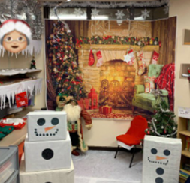
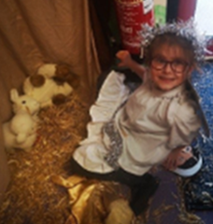
Delve & Discover Day

Slide 15
Forest School Weeks
Tîm Coed Coch & Tîm Helyg

Slide 16
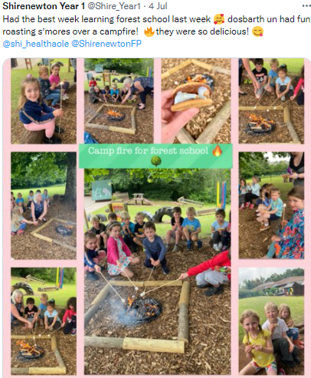
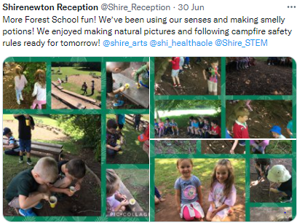
Forest School Activities

Slide 17
Muddy Maths
Tîm Coed Coch & Tîm Helyg
4 sessions each half term

Slide 18
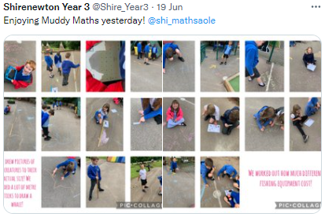
Outdoor maths using natural resources
Sorting
Matching
Ordering
Shape
Measuring
Repeated patterns
Pictograms
Adding
Subtracting
Multiplying
Dividing
Doubling
Halving

Slide 19
Enrichment Sessions
Tîm Coed Coch & Tîm Helyg
4 weekly sessions each term

Slide 20
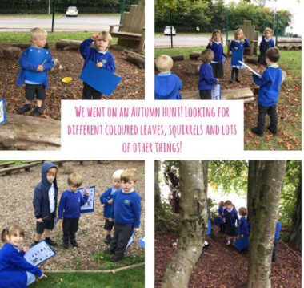
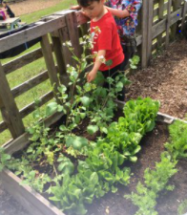
Nature Ramblers
Glorious Gardeners
Groovey Gamers
Orienteering
Multisports
Safe Cycling
Kerb Craft
Animal Husbandry
Cheerleading
Awesome Architects

Slide 21
Outdoor learning

Slide 22
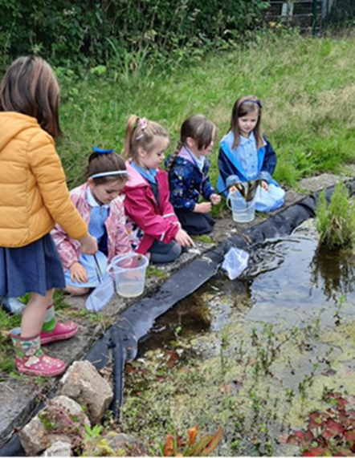
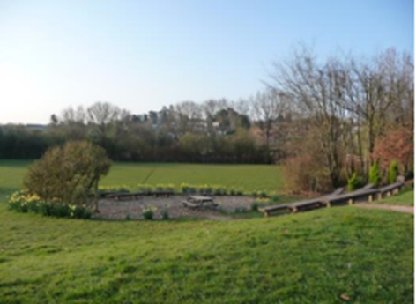
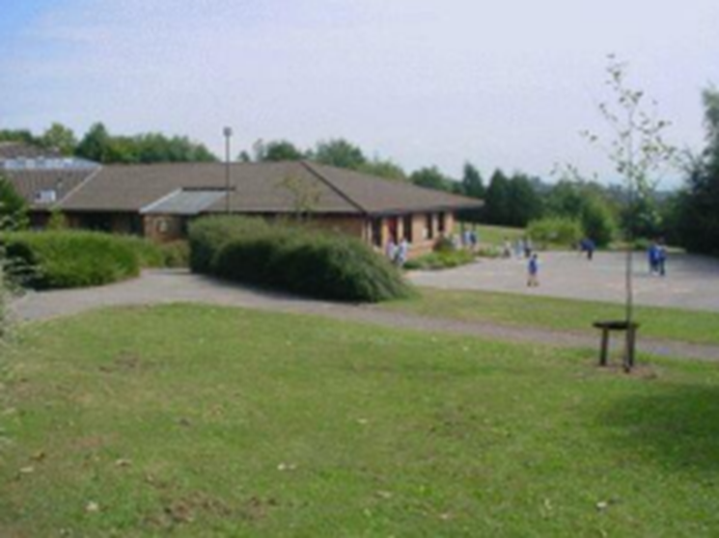
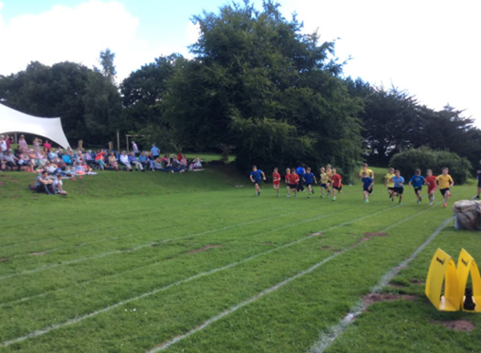
We have developed these outdoor areas ...
Two Woodland Walks
Sports Pitch
Two Playgrounds
Trim Trail
Two Log Circles
An Amphitheatre
Fruit Tree Orchard
Vegetable Plots
Poly Tunnel
A Pond

Slide 23
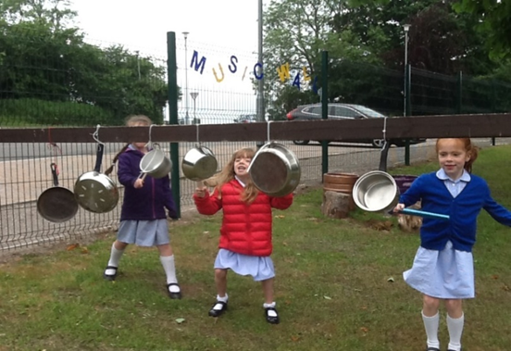
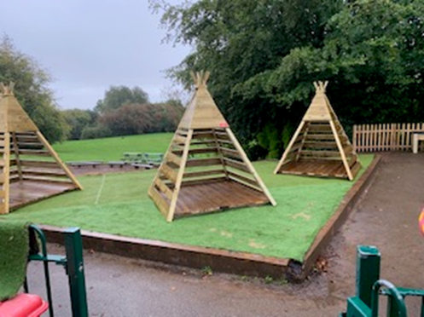
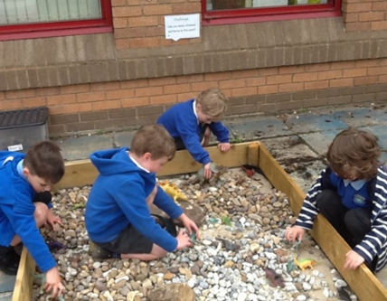
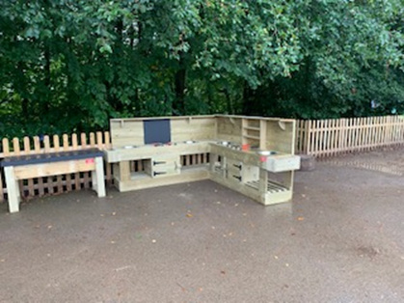
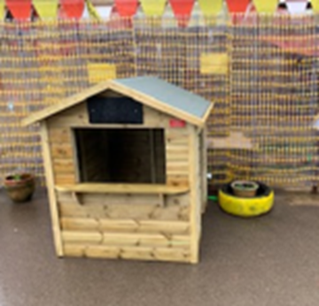
Outdoor Learning Zones
Storytellers Log Circle
Welsh Cwtsh Cottage
Gardening Area
Mud Kitchen
Tepee Village
Music area
Water Shelter
Patio
Gravel Pit
Whatever you want it to be Hut!!

Slide 24
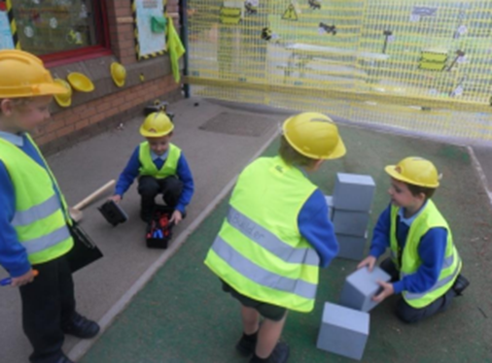
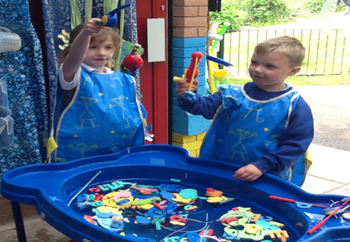
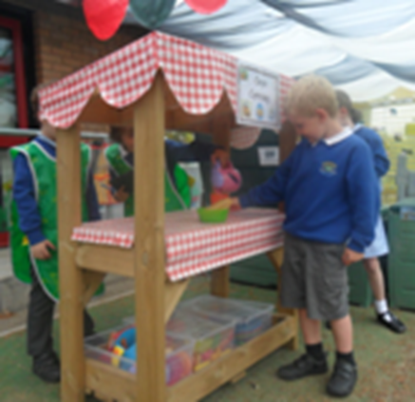
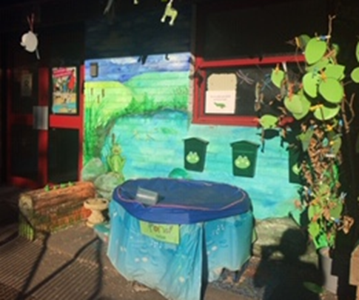
Sheltered Play Areas
Builder’s Yard
Construction Site
Water Trays
Water Wall
Fred’s Pond (RWI)
Role Play
Sand Pit
Shop
Tuff Spots
Green Screen & Stage

Slide 25
Supporting the pathway into school

Slide 26
Every pre-school setting shares information
Playgroup visit
“Meet & Greet”
“Stay & Play”
“All about me” completed by parent/ carer
Staggered start in September
Additional part time timetable, if needed

Slide 27
What does a typical school day look like?

Slide 28
Pupil Leadership Team

Slide 29
Diolch Yn Fawr!
Any questions?

